Slide 1
- Getting started - Sale
Tryton By Example
Github - https://github.com/clixwise/tryton-by-example Version of presentation : 6.0 Version of Tryton : 6.0 Verified for execution on : Windows 10 & Powershell 7 Licence : CC BY 4.0 Author : Marc Rottiers

Slide 2
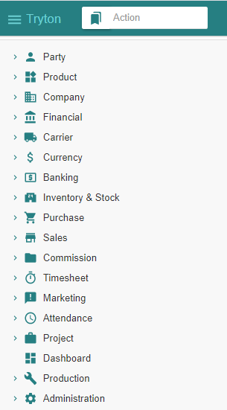
Table of Contents

Slide 3
TOC
Customer
Product
Inventory & Stock
Sale
State Change - Impact Analysis Model
Customer Sale
Customer Shipment
Customer Invoice
Customer Payment
Customer-related modules have been activated
Product-related modules have been activated
Stock-related modules have been activated
Activating Sale-related modules
The entities that record changes when performing “Sale” related operations
Recording a Sale
Recording a Shipment
Emitting an Invoice
Paying an Invoice

Slide 4
Chart of Accounts (Recap)

Slide 5
Chart of Account
We have installed the « French » chart of accounts : refer to « Basic Functionality » document.
We use the following accounts for the sale process
Balance Sheet Accounts
Income Statement Accounts
# | French | English
40 | Client | Customer
53 | Caisse | Cash
# | French | English
7x | Revenus | Revenue

Slide 6
Customer

Slide 7
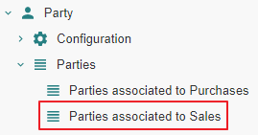
Motivation
Customers are named « Parties associated to Sales ». We name them hereafter « Customer » for commodity.
Customers are in fact party entity roles : any party promotes to a customer as soon as one or more sales are linked to it. Same for purchases.
Creation : a customer can be defined by creating an instance with the Menu Tree Item
« Parties » or
« Parties associated to Sales » if it exists (see Access hereafter).
Access : as long as no sale is linked to a party, it is not recognized as a customer and will only be accessible using the Menu Tree Item « Parties ».
Note finally that « Party » modules have been activated as explained in the previous document « Basic Functionality ».

Slide 8
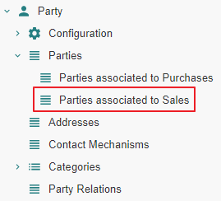
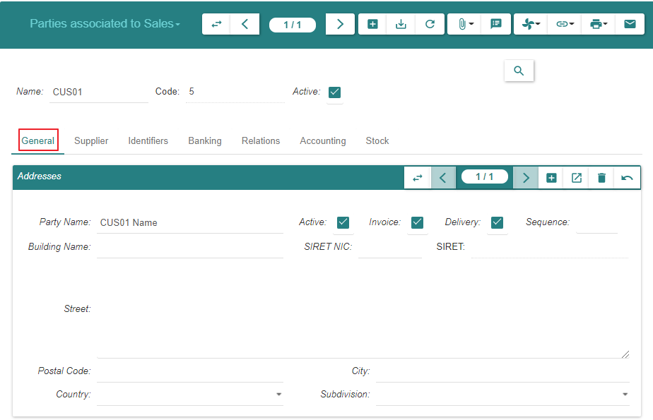
Create

Slide 9
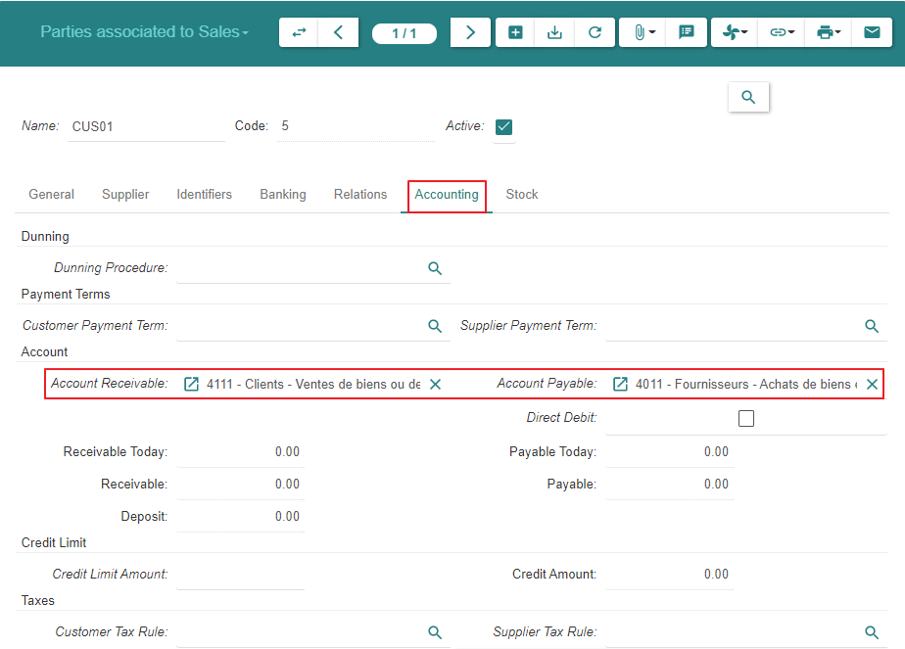
Create

Slide 10
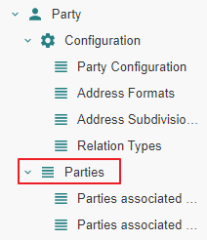
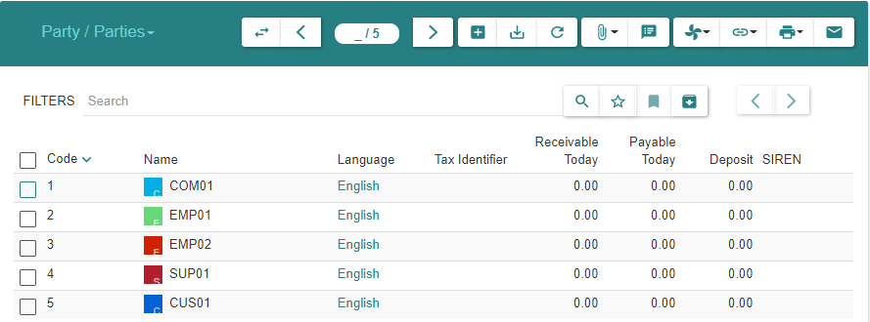
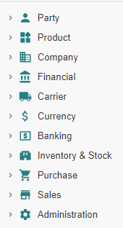
Summary
As explained under « Motivation », the customer always appears in the list « Parties » above
As long as there are no sales linked to the customer, it is absent from « Parties associated to Sales »
When at least one sale exists, the customer will appear in both lists : « Parties » and « Parties associated to Sales »

Slide 11
Product

Slide 12
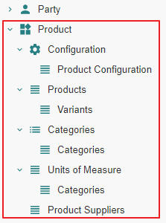
Motivation
Subject Area « Purchase » : « Product » related modules have been activated
Subject Area « Purchase » : a « Product » and its « Variant » have been defined

Slide 13
Inventory & Stock

Slide 14
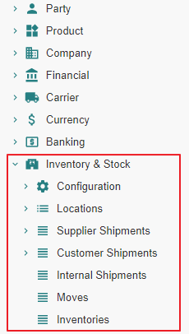
Motivation
Subject Area « Purchase » : « Inventory & Stock » related modules have been activated

Slide 15
Sale

Slide 16
Module Activation

Slide 17
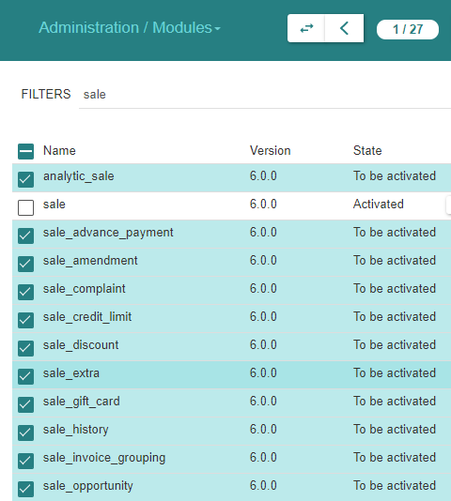
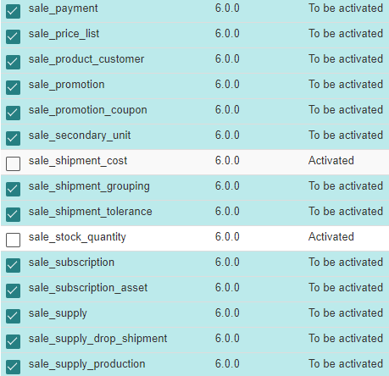
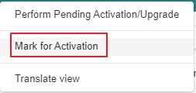
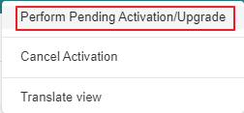
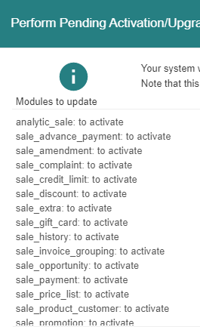
Module Activation

Slide 18
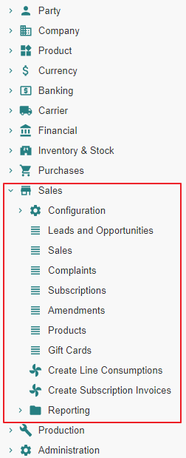
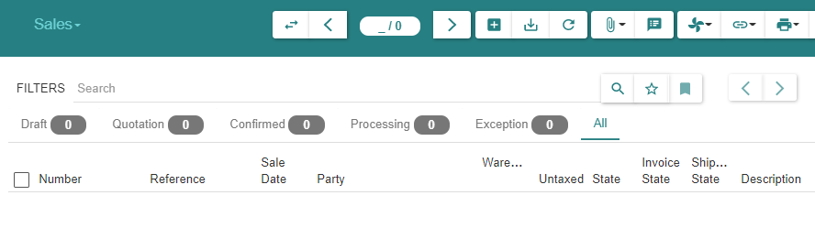
State « Post »

Slide 19
Sale Configuration

Slide 20
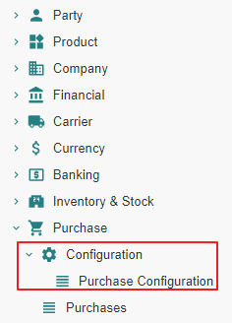
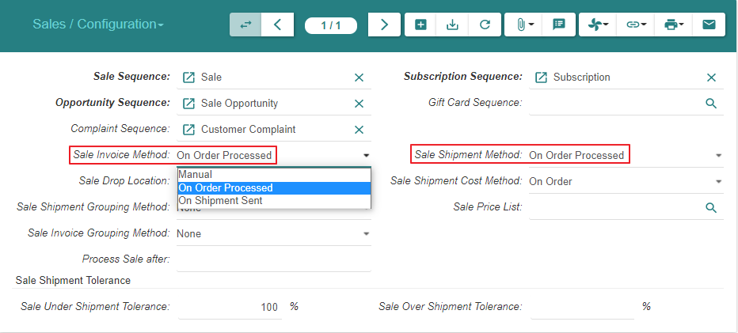
Sale Configuration (1/2)

Slide 21
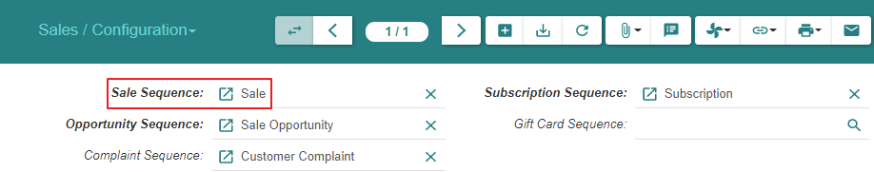
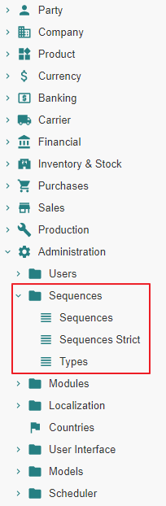
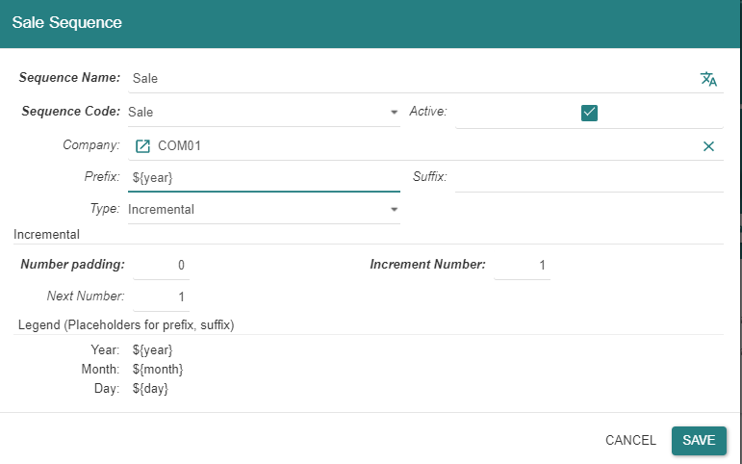
Sale Configuration (2/2)
Note : all sequences are also accessible thru Menu Tree Item « Administration / Sequences »

Slide 22
Sale - State Changes - Impact Analysis Model

Slide 23
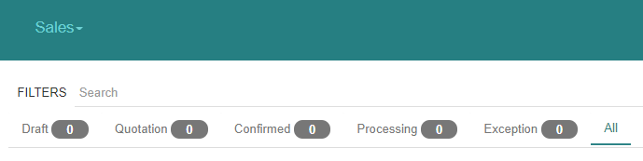
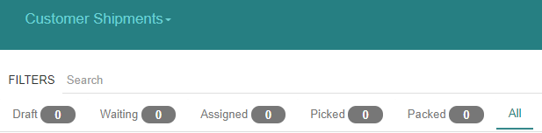
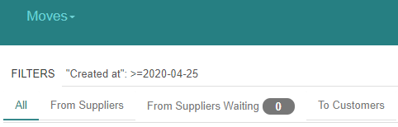
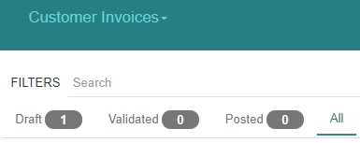
« Sales » related states

Slide 24
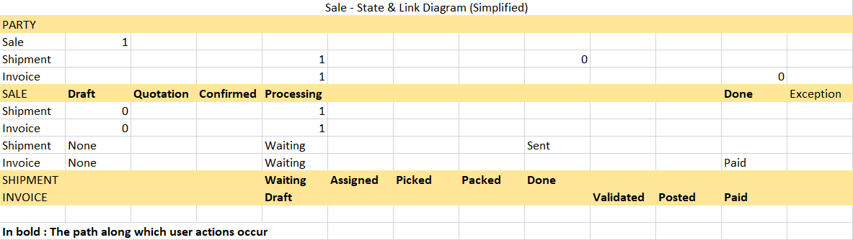
The basic State Diagram for « Sales »
The diagram does not display the action that triggers the state transition

Slide 25
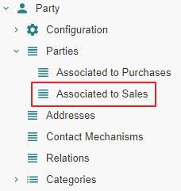
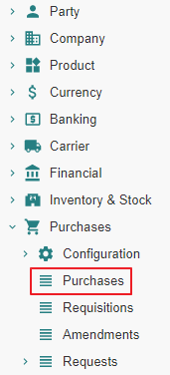
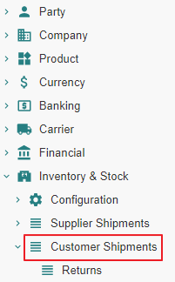
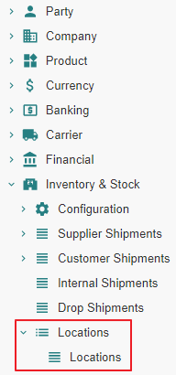
Impact analysis

Slide 26
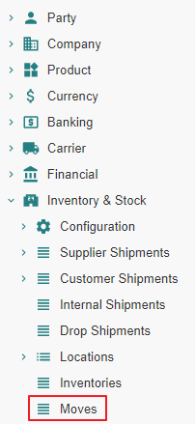
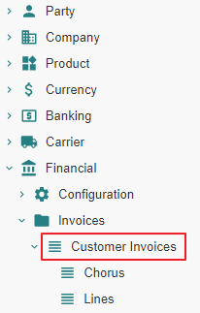
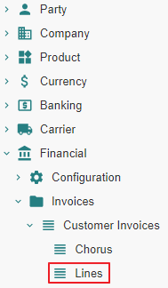
Impact analysis

Slide 27
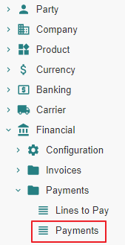
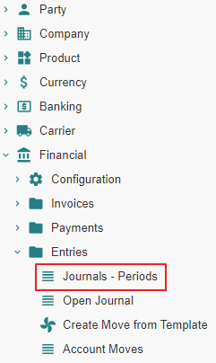
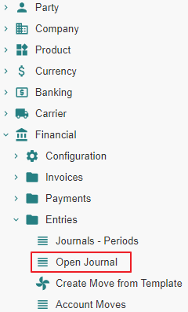
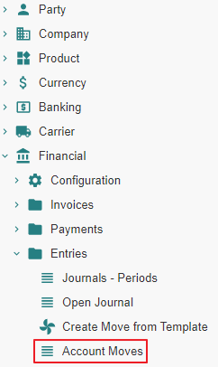
Impact analysis

Slide 28
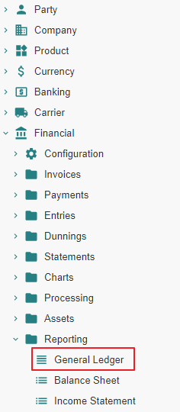
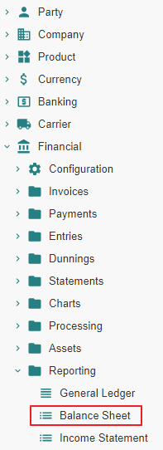
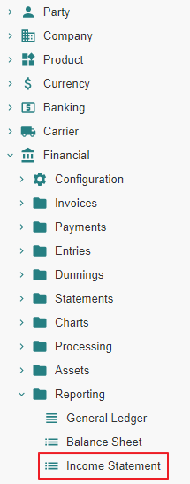
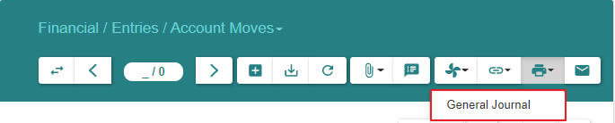
Impact analysis

Slide 29
Customer Sale - State Changes - Impact Analysis

Slide 30
Sale From State « Nill » to State « Draft »

Slide 31
Sale From State « Nill » to State « Draft » Action

Slide 32
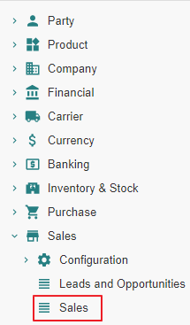
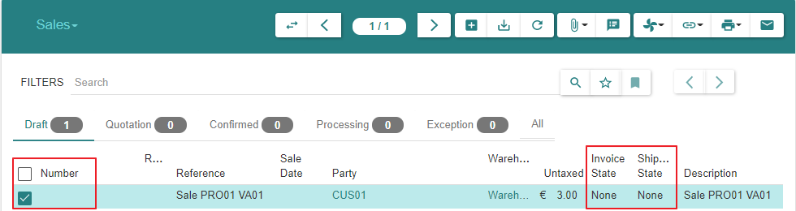
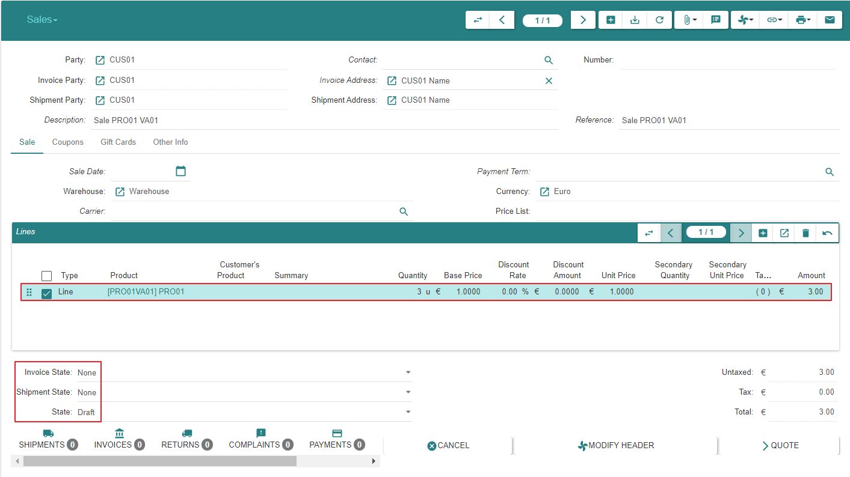
Sale
Sales are not numbered whilst they are in state « Draft »

Slide 33
Sale From State « Nill » to State « Draft » Impact

Slide 34
Sale - From « Nill » To « Draft »
 |  | State | Created - Updated - Deleted -Linked
Customer
Parties associated to Sales | 1 |  | Linked to Sale
Sale
Sales (Customer) | 2 | Draft | Created
Shipment
Customer Shipments (Customer) | 3
Stock
Stock Locations | 4
Stock Moves | 5
Invoice
Invoices (Customer) | 6
Invoice Lines | 7
Payment
Lines to Pay | 8
Payments | 9

Slide 35
Sale - From « Nill » To « Draft »
 |  | State | Created - Updated - Deleted -Linked
Accounting
Journals - Periods | 10
Account Moves | 11
Open Journal | 12
General Ledger | 13
Balance Sheet | 14
Income Statement | 15
General Journal | 16

Slide 36
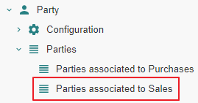
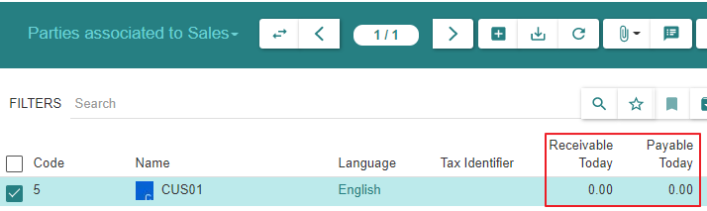
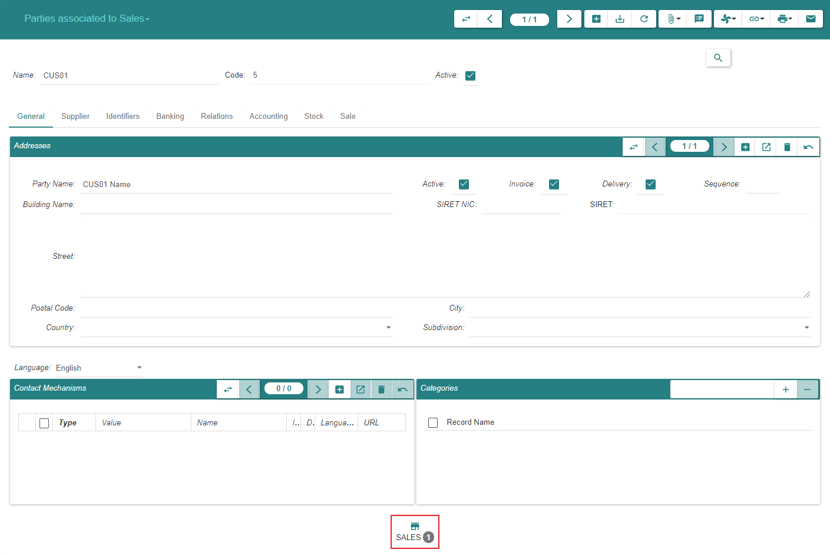
1 - Parties associated to Sales
We can navigate to « Sales », « Shipments » or « Invoices » from here on or from Menu Items

Slide 37
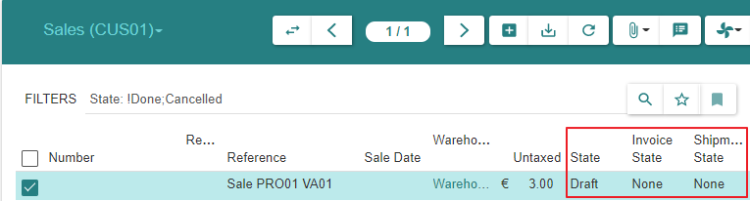
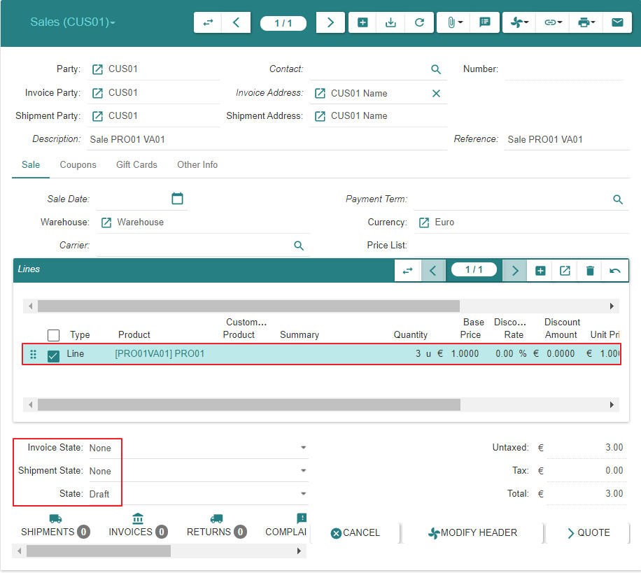
2 - Sales | Sales (SUP01)

Slide 38


8 - Lines to Pay

Slide 39


9 - Payments

Slide 40




10 - Journals - Periods

Slide 41


11 - Account Moves

Slide 42

11 - Account Moves

Slide 43


12 - Open Journal

Slide 44


12 - Open Journal

Slide 45


13 - General Ledger

Slide 46


14 - Balance Sheet

Slide 47

14 - Balance Sheet

Slide 48


16 - General Journal

Slide 49
Sale From State « Draft » to State « Quotation »

Slide 50
Sale From State « Draft » to State « Quotation » Action

Slide 51


Sale
Sales are numbered when they reach state « Quotation »
Sales can be returned to state « Draft », e.g. when the price has been renegociated with the « Customer »

Slide 52
Sale From State « Draft » to State « Quotation » Impact

Slide 53
Sale - From « Draft » To « Quotation »
 |  | State | Created - Updated - Deleted -Linked
Customer
Parties associated to Sales | 1 |  | Linked to Sale
Sale
Sales (Customer) | 2 | Quotation | Updated
Shipment
Customer Shipments (Customer) | 3
Stock
Stock Locations | 4
Stock Moves | 5
Invoice
Invoices (Customer) | 6
Invoice Lines | 7
Payment
Lines to Pay | 8
Payments | 9

Slide 54
Sale - From « Draft » To « Quotation »
 |  | State | Created - Updated - Deleted -Linked
Accounting
Journals - Periods | 10
Account Moves | 11
Open Journal | 12
General Ledger | 13
Balance Sheet | 14
Income Statement | 15
General Journal | 16

Slide 55


1 - Parties associated to Sales
We can navigate to « Sales », « Shipments » or « Invoices » from here on or from Menu Items

Slide 56


2 - Sales | Sales (CUS01)

Slide 57
Sale From State « Quotation » to State « Confirmed » or From State « Quotation » to State « Processing »

Slide 58
Sale From State « Quotation » to State «Processing »

Slide 59
Sale From State « Quotation » to State «Processing » Action

Slide 60
State transitions
Upon « Confirm » action by the user, a « Sale » or « Purchase » evolves from state « Quotation » to :
State « Confirmed » when a latent sale processing error condition exists
State « Processing » when such error does not exist.
- In the present scenario, there is no error condition and the state transition is from « Quotation » to « Processing »
Confirmed
Confirm
-
Sale Processing related Error Condition Exists
Confirm
-
Sale Processing related Error Condition Resolved
Confirm
-
Sale Processing possible
Confirm
Quotation
Processing

Slide 61


Sale

Slide 62

Sale

Slide 63
Sale From State « Quotation » to State «Processing » Impact

Slide 64
Sale - From « Quotation » To « Processing »
 |  | State | Created - Updated - Deleted -Linked
Customer
Parties associated to Sales | 1 |  | Linked to Sale
Sale
Sales (Customer) | 2 | Processing | Updated
Shipment
Customer Shipments (Customer) | 3 | Waiting | Created
Stock
Stock Locations | 4
Stock Moves | 5 | Draft [Storage to Output] ; Draft [Output to Customer] | Created [Storage to Output] ; Created [Output to Customer]
Invoice
Invoices (Customer) | 6 | Draft | Created
Invoice Lines | 7
Payment
Lines to Pay | 8
Payments | 9

Slide 65
Sale - From « Quotation » To « Processing »
 |  | State | Created - Updated - Deleted -Linked
Accounting
Journals - Periods | 10
Account Moves | 11
Open Journal | 12
General Ledger | 13
Balance Sheet | 14
Income Statement | 15
General Journal | 16

Slide 66

1 - Parties associated to Sales

Slide 67



2 - Sales | Sales (CUS01)

Slide 68


3 - Customer Shipments | Customer Shipments (CUS01)
The « Customer Shipment » is created in state « Waiting », not « Draft »
Althoug the « Customer Shipment » can be reverted subsequently to state « Draft », it should be noted that its property « Reference » cannot be edited anymore

Slide 69


3 - Customer Shipments | Customer Shipments (CUS01)

Slide 70


4 - Stock Locations

Slide 71




4 - Stock Locations : Storage Zone - Output Zone - Customer

Slide 72

5 - Stock Moves

Slide 73

5 - Stock Moves

Slide 74

5 - Stock Moves

Slide 75



6 - Invoices | Invoices (CUS01)

Slide 76

6 - Invoices | Invoices (CUS01)

Slide 77


7 - Invoice Lines

Slide 78
Customer Shipment - State Changes - Actual States

Slide 79
Motivation
It is certainly possible to process the shipment(s) pertaining to a « Sale » using the « Move » menu item.
However, it is recommended to proceed using the « Customer Shipment » functionality which will manage the following stock moves in a coherent fashion :
« Storage Moves » between the warehouse storage location and the warehouse output location
« Outgoing Moves » between the warehouse output location and the customer location

Slide 80
Customer Shipment « Nill » To « Draft »

Slide 81
Creation
The « Customer Shipment » is initially created in state « Waiting », not « Draft »
This occurs when the « Sale » evolves into state « Processing »
Hence, we do not document the inexisting state « Draft »

Slide 82
Customer Shipment « Nill » To « Waiting »

Slide 83
Creation
The « Customer Shipment » is created in state « Waiting »
This occurs when « Sale » evolves into state « Processing »

Slide 84
Customer Shipment « Waiting » To « Assigned »

Slide 85
Customer Shipment From « Waiting » To « Assigned » Action

Slide 86

Customer Shipments - Inventory Moves

Slide 87

Customer Shipments - Outgoing Moves

Slide 88
Customer Shipment From « Waiting » To « Assigned » Impact

Slide 89
Customer Shipment - From « Waiting » To « Assigned »
 |  | State | Created - Updated - Deleted -Linked
Customer
Parties associated to Sales | 1 |  | Linked to Sale
Sale
Sales (Customer) | 2 | Processing | Updated
Shipment
Customer Shipments (Customer) | 3 | Assigned | Updated
Stock
Stock Locations | 4 |  | Updated [Storage Zone += Move ; Output Zone -= Move]
Stock Moves | 5 | Assigned [Storage to Output] ; Draft [Output to Customer] | Updated [Storage to Output] ; Created [Output to Customer]
Invoice
Invoices (Customer) | 6 | Draft | Created
Invoice Lines | 7
Payment
Lines to Pay | 8
Payments | 9

Slide 90
Customer Shipment - From « Waiting » To « Assigned »
 |  | State | Created - Updated - Deleted -Linked
Accounting
Journals - Periods | 10
Account Moves | 11
Open Journal | 12
General Ledger | 13
Balance Sheet | 14
Income Statement | 15
General Journal | 16

Slide 91


2 - Sales | Sales (CUS01)

Slide 92



3 - Customer Shipments | Customer Shipments (CUS01)

Slide 93


5 - Stock Moves

Slide 94
Customer Shipment From « Assigned » to « Picked »

Slide 95
Customer Shipment From « Assigned » to « Picked » Action

Slide 96

Customer Shipments - Inventory Moves

Slide 97

Customer Shipments - Outgoing Moves

Slide 98
Customer Shipment From « Assigned » to « Picked » Impact

Slide 99
Customer Shipment - From « Assigned » To « Picked »
 |  | State | Created - Updated - Deleted -Linked
Customer
Parties associated to Sales | 1 |  | Linked to Sale
Sale
Sales (Customer) | 2 | Processing | Updated
Shipment
Customer Shipments (Customer) | 3 | Picked | Updated
Stock
Stock Locations | 4 |  | Updated [Storage Zone += Move ; Output Zone -= Move]
Stock Moves | 5 | Done [Storage to Output] ; Draft [Output to Customer] | Updated [Storage to Output] ; Created [Output to Customer]
Invoice
Invoices (Customer) | 6 | Draft | Created
Invoice Lines | 7
Payment
Lines to Pay | 8
Payments | 9

Slide 100
Customer Shipment - From « Assigned » To « Picked »
 |  | State | Created - Updated - Deleted -Linked
Accounting
Journals - Periods | 10
Account Moves | 11
Open Journal | 12
General Ledger | 13
Balance Sheet | 14
Income Statement | 15
General Journal | 16

Slide 101



3 - Customer Shipments | Customer Shipments (CUS01)

Slide 102

5 - Stock Moves

Slide 103
Customer Shipment From « Picked » to « Packed »

Slide 104
Customer Shipment From « Picked » to « Packed » Action

Slide 105


Customer Shipments - Inventory Moves

Slide 106

Customer Shipments - Outgoing Moves

Slide 107
Customer Shipment From « Picked » to « Packed » Impact

Slide 108
Customer Shipment - From « Picked » To « Packed »
 |  | State | Created - Updated - Deleted -Linked
Customer
Parties associated to Sales | 1 |  | Linked to Sale
Sale
Sales (Customer) | 2 | Processing | Updated
Shipment
Customer Shipments (Customer) | 3 | Packed | Updated
Stock
Stock Locations | 4 |  | Updated [Storage Zone += Move ; Output Zone -= Move]
Stock Moves | 5 | Done [Storage to Output] ; Assigned [Output to Customer] | Updated [Storage to Output] ; Created [Output to Customer]
Invoice
Invoices (Customer) | 6 | Draft | Created
Invoice Lines | 7
Payment
Lines to Pay | 8
Payments | 9

Slide 109
Customer Shipment - From « Picked » To « Packed »
 |  | State | Created - Updated - Deleted -Linked
Accounting
Journals - Periods | 10
Account Moves | 11
Open Journal | 12
General Ledger | 13
Balance Sheet | 14
Income Statement | 15
General Journal | 16

Slide 110



3 - Customer Shipments | Customer Shipments (CUS01)

Slide 111

3 - Customer Shipments | Customer Shipments (CUS01)

Slide 112
4 - Stock Locations : Storage Zone - Output Zone - Customer

Slide 113



4 - Stock Locations : Storage Zone - Output Zone - Customer

Slide 114

5 - Stock Moves

Slide 115
Customer Shipment From « Packed » to « Done »

Slide 116
Customer Shipment From « Packed » to « Done » Action

Slide 117

Customer Shipments - Inventory Moves

Slide 118

Customer Shipments - Outgoing Moves

Slide 119
Customer Shipment From « Packed » to « Done » Impact

Slide 120
Customer Shipment - From « Packed » To « Done »
 |  | State | Created - Updated - Deleted -Linked
Customer
Parties associated to Sales | 1 |  | Linked to Sale
Sale
Sales (Customer) | 2 | Processing | Updated
Shipment
Customer Shipments (Customer) | 3 | Done | Updated
Stock
Stock Locations | 4 |  | Updated [Storage Zone += Move ; Output Zone -= Move]
Stock Moves | 5 | Done [Storage to Output] ; Done [Output to Customer] | Updated [Storage to Output] ; Created [Output to Customer]
Invoice
Invoices (Customer) | 6 | Draft | Created
Invoice Lines | 7
Payment
Lines to Pay | 8
Payments | 9

Slide 121
Customer Shipment - From « Packed » To « Done »
 |  | State | Created - Updated - Deleted -Linked
Accounting
Journals - Periods | 10
Account Moves | 11
Open Journal | 12
General Ledger | 13
Balance Sheet | 14
Income Statement | 15
General Journal | 16

Slide 122

1 - Parties associated to Sales

Slide 123


2 - Sales | Sales (CUS01)

Slide 124



3 - Customer Shipments | Customer Shipments (CUS01)

Slide 125
4 - Stock Locations

Slide 126



4 - Stock Locations : Storage Zone - Output Zone - Customer

Slide 127

5 - Stock Moves

Slide 128
Customer Invoice - State Changes - Actual States

Slide 129
Customer Invoice « Nill » To « Draft »

Slide 130
Creation
The « Customer Invoice » is initially created in state « Draft »
The system creates such invoice when the « Sale » evolves into state « Processing »

Slide 131


Invoice

Slide 132
Customer Invoice « Draft » To « Validated »

Slide 133
Customer Invoice From « Draft » To « Validated » Action

Slide 134


Customer Invoices (1/2)

Slide 135

Customer Invoices (2/2)

Slide 136
Customer Invoice From « Draft » To « Validated » Impact

Slide 137
Customer Invoice - From « Draft » To « Validated »
 |  | State | Created - Updated - Deleted -Linked
Customer
Parties associated to Sales | 1 |  | Linked to Sale
Sale
Sales (Customer) | 2 | Processing | Updated
Shipment
Customer Shipments (Customer) | 3 | Done | Updated
Stock
Stock Locations | 4 |  | Updated [Storage Zone += Move ; Output Zone -= Move]
Stock Moves | 5 | Done [Storage to Output] ; Done [Output to Customer] | Updated [Storage to Output] ; Created [Output to Customer]
Invoice
Invoices (Customer) | 6 | Validated | Updated
Invoice Lines | 7
Payment
Lines to Pay | 8
Payments | 9

Slide 138
Customer Shipment - From « Packed » To « Done »
 |  | State | Created - Updated - Deleted -Linked
Accounting
Journals - Periods | 10
Account Moves | 11
Open Journal | 12
General Ledger | 13
Balance Sheet | 14
Income Statement | 15
General Journal | 16

Slide 139

1 - Parties associated to Sales

Slide 140


2 - Sales | Sales (CUS01)

Slide 141
6 - Invoices | Invoices (CUS01) (1/2)

Slide 142
6 - Invoices | Invoices (CUS01) (2/2)

Slide 143



10 - Journals - Periods

Slide 144

11 - Account Moves

Slide 145

12 - Open Journal

Slide 146

13 - General Ledger

Slide 147
14 - Balance Sheet

Slide 148
14 - Balance Sheet

Slide 149
16 - General Journal

Slide 150
Customer Invoices From State « Validated » to State « Posted »

Slide 151

Motivation
https://www.accountingtools.com/articles/what-is-posting-in-accounting.html

Slide 152
Customer Invoices From State « Validated » to State « Posted » Action

Slide 153


Customer Invoices (1/2)

Slide 154

Customer Invoices (2/2)

Slide 155
Customer Invoices From State « Validated » to State « Posted » Impact

Slide 156
Customer Invoice - From « Validated » to « Posted »
 |  | State | Created - Updated - Deleted -Linked
Customer
Parties associated to Sales | 1 |  | Linked to Sale
Sale
Sales (Customer) | 2 | Processing | Updated
Shipment
Customer Shipments (Customer) | 3 | Done | Updated
Stock
Stock Locations | 4 |  | Updated [Storage Zone += Move ; Output Zone -= Move]
Stock Moves | 5 | Done [Storage to Output] ; Done [Output to Customer] | Updated [Storage to Output] ; Created [Output to Customer]
Invoice
Invoices (Customer) | 6 | Posted | Updated
Invoice Lines | 7
Payment
Lines to Pay | 8
Payments | 9

Slide 157
Customer Invoice - From « Validated » to « Posted »
Accounting
Journals - Periods | 10 | Posted [Account Move Lines] | Created [Account Move Lines : 4111 - 7011]
Account Moves | 11 | Posted [Account Move Lines] | Created [Account Move Lines : 4111 - 7011]
Open Journal | 12 | Posted [Account Move Lines] | Created [Account Move Lines : 4111 - 7011] ; Journal « Revenue » for Q1
General Ledger | 13 |  | Updated [Accounts 4111 & 7011]
Balance Sheet | 14 |  | Updated [Accounts 4111]
Income Statement | 15 |  | Updated [Accounts 7011]
General Journal | 16 | Posted [Account Move Lines] | Created [Account Move Lines : 4111 - 7011]
Accounting

Slide 158


1 - Parties associated to Sales

Slide 159


2 - Sales | Sales (CUS01)

Slide 160
6 - Customer Invoices (1/2)

Slide 161
6 - Customer Invoices (2/2)

Slide 162

8 - Lines to Pay

Slide 163
9 - Payments

Slide 164



10 - Journals - Periods

Slide 165

11 - Account Moves

Slide 166

11 - Account Moves

Slide 167

11 - Account Moves

Slide 168




12 - Open Journal

Slide 169

13 - General Ledger

Slide 170

14 - Balance Sheet

Slide 171

14 - Balance Sheet

Slide 172

15 - Income Statement

Slide 173

16 - General Journal

Slide 174
Customer Payment - State Changes - Actual States

Slide 175
Payment

Slide 176
Payment Precondition

Slide 177




Invoice Payment Method

Slide 178
Payment Action

Slide 179



Customer Invoices (1/2)

Slide 180

Customer Invoices (2/2)

Slide 181
Payment Impact

Slide 182
Payment
 |  | State | Created - Updated - Deleted -Linked
Customer
Parties associated to Sales | 1 |  | Linked to Sale
Sale
Sales (Customer) | 2 | Done | Updated
Shipment
Customer Shipments (Customer) | 3 | Done | Updated
Stock
Stock Locations | 4 |  | Updated [Storage Zone += Move ; Output Zone -= Move]
Stock Moves | 5 | Done [Storage to Output] ; Done [Output to Customer] | Updated [Storage to Output] ; Created [Output to Customer]
Invoice
Invoices (Customer) | 6 | Paid | Updated
Invoice Lines | 7
Payment
Lines to Pay | 8
Payments | 9

Slide 183
Payment
Accounting
Journals - Periods | 10 | Posted [Account Move Lines] | Created [Account Move Lines : 4111 - 7011]
Account Moves | 11 | Posted [Account Move Lines] | Created [Account Move Lines : 4111 - 7011]
Open Journal | 12 | Posted [Account Move Lines] | Created [Account Move Lines : 4111 - 7011] ; Journal « Revenue » for Q1
General Ledger | 13 |  | Updated [Accounts 4111 & 7011]
Balance Sheet | 14 |  | Updated [Accounts 4111]
Income Statement | 15 |  | Updated [Accounts 7011]
General Journal | 16 | Posted [Account Move Lines] | Created [Account Move Lines : 4111 - 7011]
Accounting

Slide 184


1 - Parties associated to Sales

Slide 185

1 - Parties associated to Sales

Slide 186


2 - Sales | Sales (CUS01)

Slide 187
6 - Customer Invoices (1/2)

Slide 188
6 - Customer Invoices (2/2)

Slide 189

10 - Journals - Periods

Slide 190

11 - Account Moves

Slide 191
11 - Account Moves

Slide 192

11 - Account Moves

Slide 193

12 - Open Journal

Slide 194
13 - General Ledger

Slide 195

14 - Balance Sheet

Slide 196

14 - Balance Sheet

Slide 197

16 - General Journal

